Slide 1
Final Project
Shuo-Yen Chueh

Slide 2
Introduction: Brain computer interface experiment

Slide 3
Behavioral data format

Slide 4
Behavioral data format

Slide 5
Behavioral data format

Slide 6
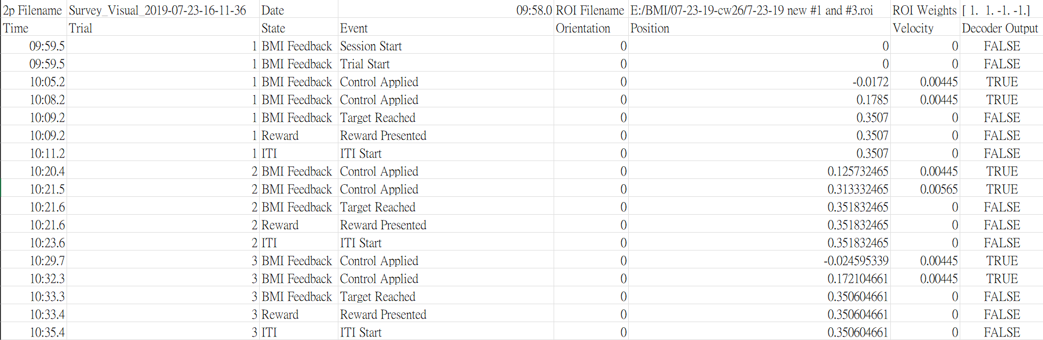
Behavioral data format
Behavioral experiment set up
Trial 1
Random start point
Trial 2

Slide 7
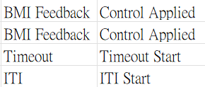
Behavioral data format
Behavioral experiment set up
Trial 1
Random start point
Trial 2
There are also other parameters to tune the behavioral set up, e.g. Impulse, max_velocity, stop & start threshold, random_start_range, ITI length…etc
Failed trial if time out

Slide 8
The purpose of original MATLAB code
Extract the basic information: 1. Total experiment duration 2. Total trials and successful trial count 3. Success rate and reward frequency 4. Average and standard deviation of trial duration
Visualization of neural trajectory: 1D & 2D version, Trial path length.
Batch file analysis: Output a summarization file.
Ensemble-based group analysis: plot the bar chart of each neuron ensemble giving the statistics results.

Slide 9
Goal, not just covert into python

